Slide 1
REPRODUCTION in VERTEBRATES
Life Sciences

Slide 2
Life Sciences
Key Points: Reproduction in Vertebrates
What are Vertebrates?
External vs Internal Fertilisation
Ovipary, Vivipary and Ovovivipary
Amniotic Egg
Precocial vs Altricial Development
Parental Care

Slide 3
Life Sciences
Question
What are Vertebrates?
Answer
A large group of animals distinguished by the
possession of a backbone and internal
skeleton including fish, amphibia, reptiles,
birds and mammals.

Slide 4
Life Sciences
Question
What is the difference between External and Internal Fertilisation?

Slide 5
Life Sciences
Answer
External fertilisation is a mode of reproduction in which a male’s sperm cells fertilise ova outside of the female body. Eg fish lay eggs in water and male deposits sperm over the eggs.
Internal fertilisation is when the sperm and ovum combine inside the body of the female.

Slide 6
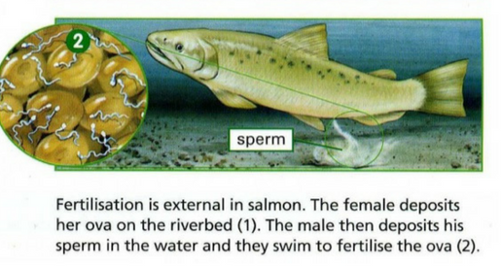
Life Sciences
External Fertilisation
Picture from www.majordifferences.com

Slide 7
Life Sciences
External fertilisation: Advantages
Spawning leads to greater genetic variation.
No energy required from the female during the incubation period.
Eggs do not dehydrate in an aquatic environment.

Slide 8
Life Sciences
External fertilisation: Disadvantages
Eggs are exposed to harsh conditions and predators.
Fertilisation is left to chance because the current can wash sperm away.
Large quantity of male and female gametes required.

Slide 9
Life Sciences
Internal fertilisation: Advantages
The fertilised ovum is well protected.
It increases the probability of fertilisation.
Specific mate selection.
The developing embryo is not exposed to external risks such as predation.

Slide 10
Life Sciences
Internal fertilisation: Disadvantages
Smaller number of offspring.
Great amount of energy required from the female during gestation.

Slide 11
Life Sciences
Ovipary, Vivipary and Ovovivipary
What is the difference?

Slide 12
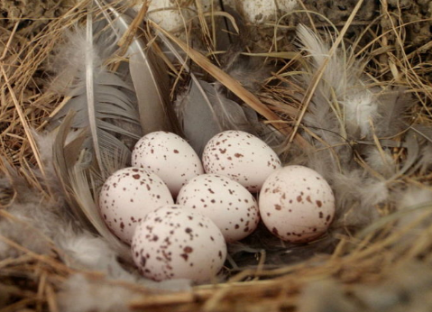
Life Sciences
Oviparity
The expulsion of undeveloped eggs. Eggs may have been fertilised before release, as in birds and some reptiles, or are to be fertilised externally, as in
amphibians and fish.

Slide 13
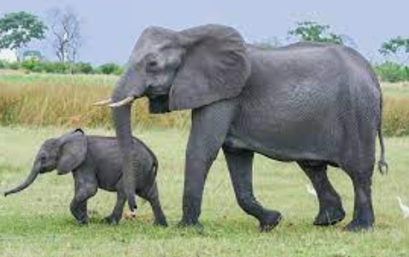
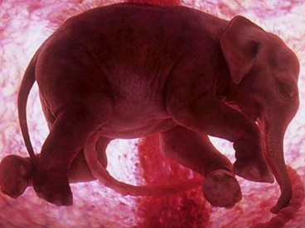
Life Sciences
Viviparity
Development of the embryo inside the body of the parent.

Slide 14
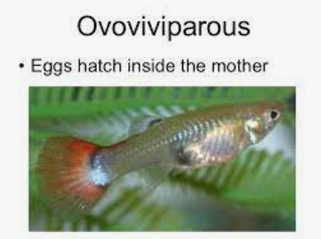
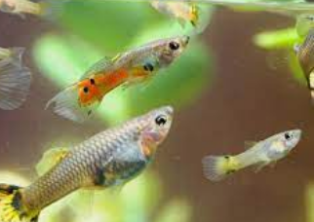
Life Sciences
Ovoviviparity
The mode of reproduction in which embryos develop inside eggs that are retained within the mother’s body
Until they are ready to hatch, e.g sharks and snakes.

Slide 15
Life Sciences
Amniotic Egg – What is it?
Amniotic eggs enable animals to reproduce on dry land. These eggs have an amniotic membrane, hard shell to protect the developing embryo. The shell also prevents dehydration and allows gases exchange, O2 and CO2.
The albumin (egg white) provides the embryo with water and protein.
The egg yolk (yellow) provides vitamins, minerals, lipids and protein to the developing embryo.

Slide 16
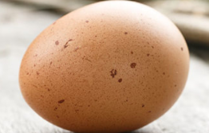
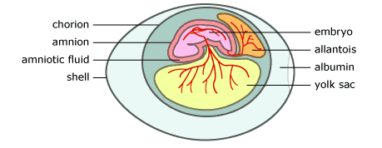
Life Sciences
Amniotic Egg
ucmp.berkeley.edu

Slide 17
Life Sciences
Key Terms – Amniotic Eggs
Amnion – The innermost membrane of the fetal membranes. The sac in which the embryo is suspended. Protects the embryo from shock and dehydration.
Chorion – Allows gases exchange from embryo to external environment.
Allantois – Stores N-wastes.

Slide 18
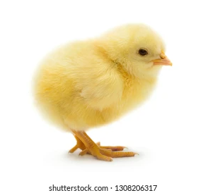
Life Sciences
Amniotic Egg
ucmp.berkeley.edu

Slide 19
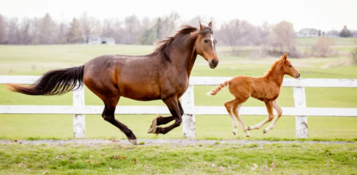
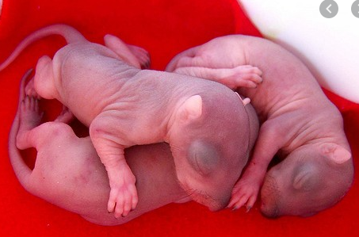
Life Sciences
Precocial Development
Altricial Development
Infant Squirrels – picture from City Wildlife

Slide 20
Life Sciences
Precocial Development
Animals hatched or born in an advanced state.
The new-born has the ability to move and feed freely.
Hearing and sight are well developed at birth.
Altricial Development
Opposite of the above, these new-borns need extensive
parental care.

Slide 21
Life Sciences
Parental Care
A contribution by parents that increases the chance of
survival of the offspring. Forms of care may include
preparing a suitable rearing environment, providing food
and defending the young against predators. Often,
animals that provide parental care, produce less offspring
but there is a greater chance of survival. In mammals there
are two major phases of care – gestation and the period of
milk production.
We appreciate what our parents have done for us!

Slide 22
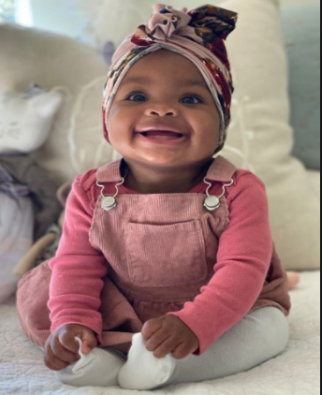
Life Sciences

