Slide 1
Cells and Nucleic Acids Exam Questions
Life Sciences

Slide 2
Life Sciences
Multiple Choice Questions
1.1
1.1.1 In a DNA molecule …
A guanine pairs with adenine.
B adenine pairs with thymine.
C cytosine pairs with adenine.
D guanine pairs with thymine.
1.1.2 A sample of DNA has 60 guanine bases and 30 adenine bases How many phosphate molecules would you expect in this sample of DNA?
A 30 B 90
C 180 D 270

Slide 3
A
T
C
G
T
A
C
G
A
T
G
C
T
A

Slide 4
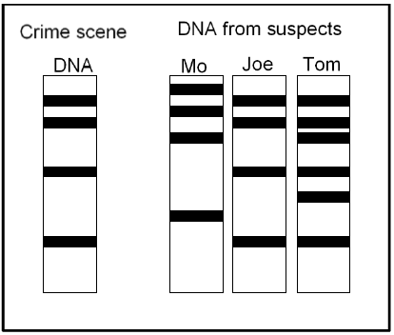
Life Sciences
Questions 1.1.3 and 1.1.4 are based on the diagram below.

Slide 5
Life Sciences
1.1.3 The procedure shown above is called …
A cloning.
B DNA replication.
C DNA profiling.
D fingerprinting.
1.1.4 The evidence in the diagram shows that …
A only Tom was present at the scene of the crime.
B Tom and Joe were present at the scene of the crime.
C only Joe was present at the scene of the crime.
D none of the three individuals were at the scene of the crime.

Slide 6
Life Sciences
Biological Terms
1.2
1.2.1 The process by which a DNA molecule makes identical copies of itself.
1.2.2 Nitrogenous base found only in RNA molecules.
1.2.3 A sugar molecule found in a nucleotide of DNA.
1.2.4 The phase in the cell cycle during which DNA replication occurs.
1.2.5 The bonds between two nitrogenous bases in a DNA-molecule.
Match Columns
1.3 Indicate whether each of the statements in COLUMN I applies to A only, B only,
both A and B or none, next to the question number in the ANSWER BOOK.

Slide 7
Life Sciences
COLUMN I | COLUMN II
1.3.1 Credited with the discovery of the structure of the DNA molecule. | A Watson B Crick
1.3.2 Location of DNA in a human cell. | A Nucleus B Mitochondrion
1.3.3 Structure of RNA | A Guanine pairs with Cytosine B Contains deoxyribose sugar
1.3.4 Significance of DNA replication | A Produce identical daughter cells. B Produce identical DNA molecules

Slide 8
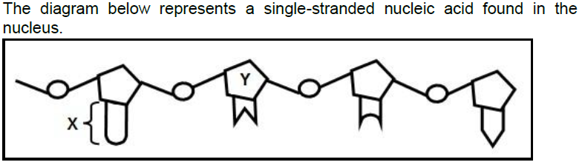
Life Sciences
Section B
2.1.1 Identify the nucleic acid in the diagram above. (1)
2.1.2 Name ONE organelle in the cytoplasm of a human cell where
this nucleic acid is found. (1)
2.1.3 Identify the structures marked X and Y in the diagram. (2)

Slide 9
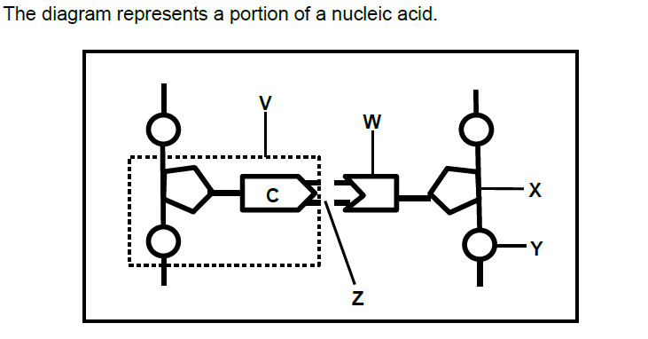
Life Sciences
Section B
2.2.1 Name the nucleic acid above (1)
2.2.2 Identify the labels V, W, X and Y. (4)

Slide 10
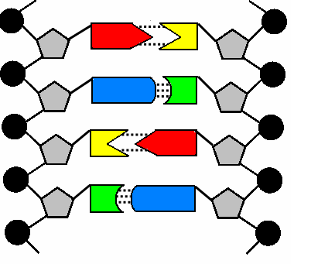
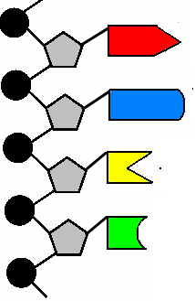
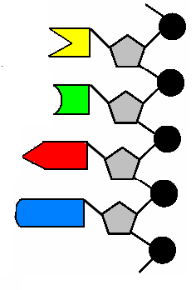
DNA Replication
Unzip into two single strands

Slide 11
2.3 Describe the process of DNA replication. (6)
Strand 1
Strand 2

Slide 12
2.3 DNA Replication – Answer (6)
With cell division - New cells require exact copies of the DNA as it is in the mother cell.
Step 1: DNA unwinds, becomes ladder-shaped.
Step 2: Weak H-bonds break, DNA molecule unzips.
Step 3: Each strand forms a complementary strand
for itself - Nucleotides attach G - C and A - T
Step 4: Each strand becomes a double helix.
The end result is TWO identical DNA molecules.
Sometimes mistakes happen – mutation

Slide 13
Life Sciences
2.4 Tabulate THREE structural differences
between DNA and RNA. (7)
DNA | RNA
Double strand | Single strand
Deoxyribose sugar | Ribose sugar
Thymine | Thymine replaced by Uracil

