Slide 1
HUMAN REPRODUCTION
Life Sciences

Slide 2
Life Sciences
Key Points: Human Reproduction
Role of Meiosis, Fertilisation and Mitosis
The Male System – Structure and Functions
Female System – Structure and Functions
Gametogenesis
Diagrams of a Sperm cell and Ovum
The Menstrual Cycle

Slide 3
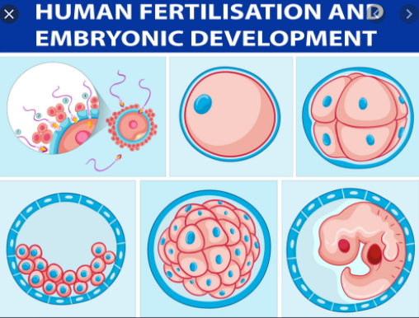
Life Sciences
From Vectorstock.com

Slide 4
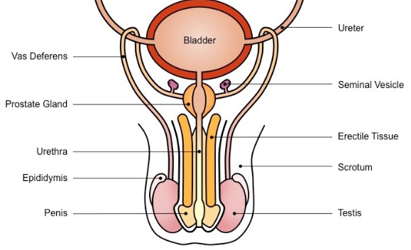
Life Sciences
Male Reproductive System
From: BioNinja

Slide 5
Life Sciences
Male System – What are the Functions of …?
Testes
Epididymis
Vas Deferens
Seminal Vesicles
Prostate Gland
Cowper’s Gland
Urethra

Slide 6
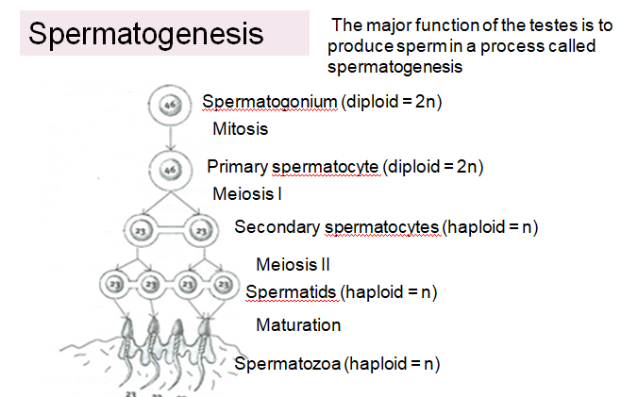
Life Sciences

Slide 7
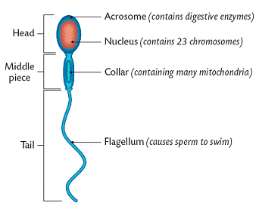
Life Sciences
Human Sperm Cell

Slide 8
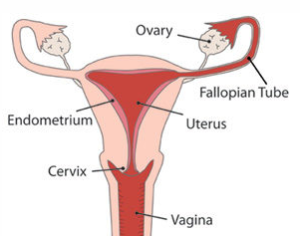
Life Sciences
Female Reproductive System

Slide 9
Life Sciences
Female System – What are the Functions of …?
Ovaries
Fallopian Tubes
Uterus
Endometrium
Cervix

Slide 10
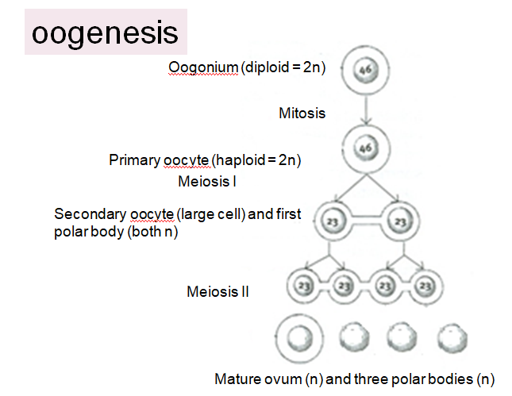
Life Sciences

Slide 11
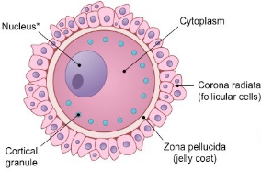
Life Sciences
Human Ovum

Slide 12
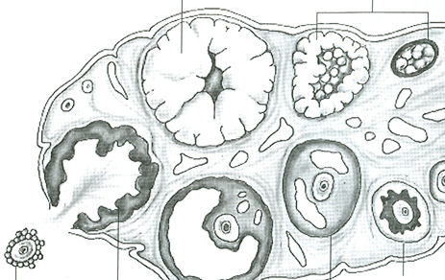
Life Sciences
Internal structure of an Ovary
Ovarian Cycle – 28 days

Slide 13
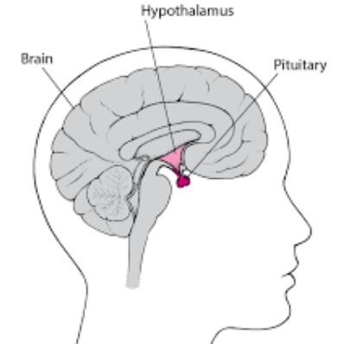
Life Sciences
Female Hormones during the Ovarian Cycle

Slide 14
Life Sciences
Menstrual Cycle: The effect of Oestrogen and Progesterone on the Uterus every 28 days

Slide 15
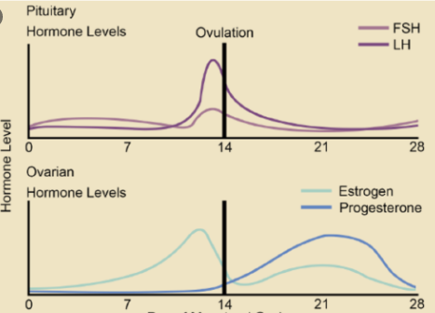
Life Sciences
Hormone Levels of the - 28 day - Menstrual Cycle
Biology LibreTexts

Slide 16
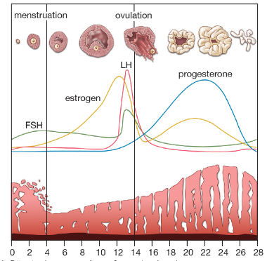
Life Sciences
Hormone Levels of the - 28 day - Menstrual Cycle
2013 Ecyclopaedia Britannica

Slide 17
Life Sciences
Key Points: Human Reproduction
Role of Meiosis, Fertilisation and Mitosis
The Male System – Structure and Functions
Female System – Structure and Functions
Gametogenesis
Diagrams of a Sperm cell and Ovum
The Menstrual Cycle

