Slide 1
TELEMATIC TEACHING PROJECT
Climate and Weather
 | HIGH PRESSURE | LOW PRESSURE
Names | Anticyclone | Cyclones
Characteristics | High pressure with sinking air. Rotates clockwise in Northern Hemisphere, and Anticlockwise in Southern Hemisphere | Low pressure with rising/ ascending air. Rotates clockwise in S.H and anticlockwise in Hemisphere
Weather conditions | Dry warmer weather. Temperature increase with 1⁰c for every 100m | Wetter cooler weather. Moist air decrease its temperature 1⁰c for every 100m

Slide 2
General characteristics of Midlatitude cyclone
Other names: Frontal depression, temperate cyclone, extra tropical cyclone
Midlatitude cyclone are found between40⁰-60º N and S Hemisphere
These cyclones occurs between 30⁰-60º N and S
Midlatitude cyclones move from West to east (driven/pushed by Westerlies)
Occurs all year round in both hemispheres; affects South Africa in winter
Associated with warm front, warm sector, cold front, cold sector
Weather conditions associated with a cold front : overcast, low temperatures, strong winds, heavy rain (Cumulonimbus clouds)
Western side of continents are affected by mid-latitudes cyclones
They rotate clockwise in S. Hemisphere and anti in N. hemisphere
They occur in families of 3-5 members with diameter of

Slide 3
How Midlatitude cyclone forms
There must be temperature contrast between westerlies and polar easterlies to form polar front.
There must be disturbance in Jet stream which pushes cold air into warm air.
A low pressure develops when warm air rises above cold air as driven by westerlies.
Conditions necessary for development of Midlatitude cyclone
Difference between land and sea temperature
Shape of coastline
Acceleration of any of air masses
Mountain ranges

Slide 4
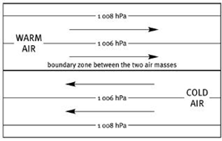
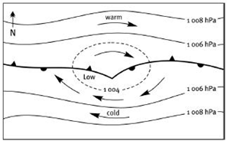
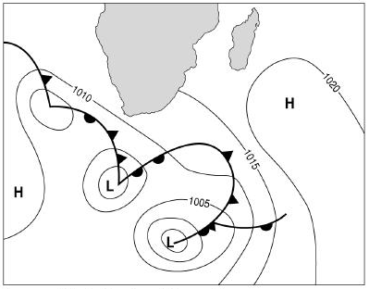
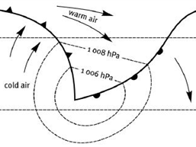
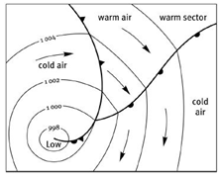
MIDLATTITUDE CYCLONE: STAGES
1 INITIAL STAGE
2 DEVELOPMENT STAGE
Westerlies
Polar easterlies
Polar front
3 MATURE STAGE
4 OCCLUSION
FAMILY OF CYCLONES
Midlatitude travels from West to East: with oldest on far South east and youngest on North West. They may follow each other as 3-5 members

Slide 5
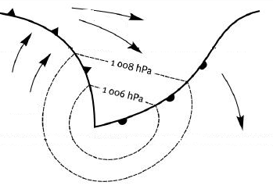
MID-LATTITUDE CYCLONE
STRATUS, CUMULUS
CUMULONIMBUS
Cold front
Warm
sector
Warm front
DRIZZLE
LIGHT RAINFALL
HEAVY RAINFALL
THUNDERSTORM
Isobar
L
Wind rotation clockwise
Cold
sector
Rotate clockwise because we are in the Southern Hemisphere

Slide 6
Weather pattern associated with fronts:
Cold front weather | Warm front weather | Warm sector weather
1.Wind backs( West to South West) | 1.Wind changes from northwest to west | 1.Pressure drops
2.Strong winds with low temperatures | 2.More humidity with high temperatures | 2.Has warm less dense air
3. Heavy rain with cumulonimbus clouds | 3.Light rain with nimbostratus clouds | 3.Associated with stratocumulus, altostratus clouds.
4. Pressure decreases as front approaches but rise as cold sector arrives | 4.Decrease in air pressure
IMPACT OF MIDLATITUDE ON HUMANS AND ENVIRONMENT
Strong winds from thunderstorms, hail, and some snow can destroy infrastructure and kill people
Communication is disrupted, shipping and aeroplanes cannot operate and out door activities
Farmers may be negatively affected because these storms may destroy their crops, but it may also be a blessing by bringing necessary rainfall

Slide 7
TROPICAL CYCLONES
 | Characteristics of Tropical cyclone
Other names | Typhoon – China/Japan Cyclone – Indian ocean Willy willies – Australia Hurricane - USA
Formation | Formed around 5⁰ N and 30⁰S Hemisphere, and does not occur at equator (0⁰) because there is no coriolis force.
Occurance | Occurs over tropics between 5⁰ to 30⁰ N and S hemisphere
Movement/ Direction | They travel from East to West driven by Easterly winds
Season | They occur late summer early autumn
Areas affected | Eastern side of continents in tropical latitudes
Weather | Intense thunderstorm, stormy vortex and the eye( centre of tropical cyclone with calm conditions)
Rotation | Rotate clockwise in Southern Hemisphere and anti-clockwise in Northern hemisphere
Life Span | They lasts a week. (4-7 days) and diameter of 200-750km
Stages
How managed

Slide 8
Factors necessary for FORMATION of tropical cyclone
Occurs in a low pressure area, between 5⁰ – 30⁰ N and S equator
Associated with heat required for uplift of air
Occur over oceans with temp above 27⁰C
Do not occur at equator due to lack of coriolis force
Characteristics
Reason
Occur over warm oceans with 27⁰C temp
Do not occur at 0⁰ to 4⁰C
Move from east to west
They die when they move inland
For constant supply of moisture
No coriolis force
They are driven by trade winds called tropical easterlies
The heat is removed, friction and moisture is cut off.
Areas where tropical cyclone forms:
Over warm oceans, between 5⁰ – 30⁰
Where there is uplift of air with temp above 27⁰C

Slide 9
ASSOCIATED WEATHER PATTERNS OF
TROPICAL CYCLONE
They are associated with dangerous weather conditions, with worse conditions on mature stage
They destroy property, environment and loss of life
Very high wind speed and cumulonimbus clouds around the eye. ( Heavy rainfall/torrential rain)
Storm surges in coastal areas with rise in sea level by many meters
IMPACT OF TROPICAL CYCLONE ON HUMANS AND ENVIRONMENT
Flooding caused by storm surge, heavy rains swollen rivers
Storm surges-sudden rise in sea level
Damage infrastructure like roads, bridges, homes, sewage communication
IMPACT OF TROPICAL C.
Disruption of tourism, trade, agriculture and industry
Outbreak of water borne diseases like cholera since floods have damaged sewages
Loss of life

Slide 10
Putting evacuations in place, for getting people out of danger area
Informing public of the risk and evacuating them
Precautions and preventative strategies of Tropical cyclone
Tracking cyclones and issuing early warnings
Rescue of people from flooded areas
CYCLONE DISASTER MANAGEMENT
Emergency relief, such as to give food, water and shelter
Aid/ help from international countries for poor countries to help them recover from long term effects of cyclones

Slide 11
REGIONAL CLIMATE
Line thunderstorms
Berg winds

Slide 12
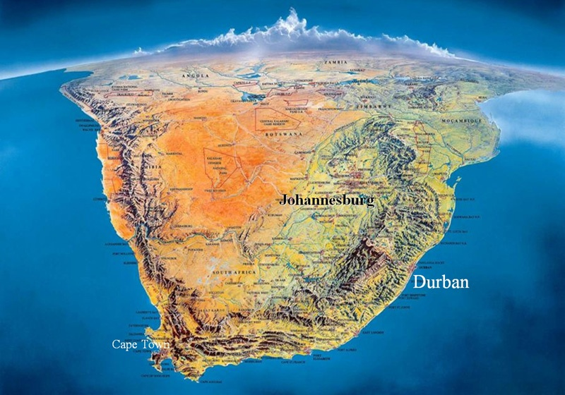

LINE THUNDERSTORMS
MOI STURE FRONT
WARM MOIST AIR
Cold Benguela
COLD DRY AIR
H
Warm Mozambique
H

Slide 13
Moisture front / Line thunderstorm
Atlantic ocean
Indian ocean
Cold air mass that blows from S.W. direction
This air mass comes from Atlantic ocean
It is influenced by Cold Benguela current
This air mass is pushed by South Atlantic H.P. / anticyclone towards the interior
Warm moist air mass that blows from N.E. direction
This air mass comes from Indian ocean
It is influenced by Mozambique ocean current
This air mass is pushed by South Indian H.P./ anticyclone towards the interior
These two air masses meet at trough axis. Warm air is forced to rise and cold air wedges underneath. A line thunderstorm develops along moisture front with heavy rainfall associated with cumulonimbus clouds

Slide 14
Coastal low and Berg Winds
Coastal low pressure
Berg winds
These are low pressure cells that often travel ahead of cold front
They form off the west coast and travel east along the coast and change coastal weather.
Rotate clockwise, with onshore winds on west that brings rain and fog and offshore winds on east with warm dry conditions
Berg winds are hot dry winds that blows from the interior towards the coast and are warmed up adiabatically as they descend: 1⁰C/100m
High pressure develops in interior and Low pressure over the coast
Temperature drops fast by the cold air behind the front, and difference in pressure btw interior and coast ceases.
Season: They occur in winter
Results of berg winds: Veld fires
Solutions: Fire fighters

Slide 15

SOUTH AFRICAN BERGWIND
Anti clockwise circulation
High pressure in interior
H
Descending air heated
Danger: Veldfires
Warm dry wind at coast
Low pressure over sea
L

Slide 16
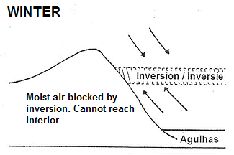
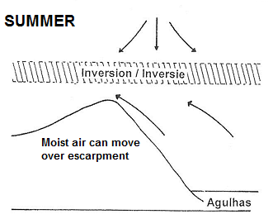
Role of inversion layer/ KALAHARI H.P
During winter the KALAHARI H.P is dominant in the interior (strong).
The inversion layer is below the escarpment
Moisture from Indian ocean driven by Aghulas and Mozambique cannot reach the interior.
The results are DRY conditions in the interior in WINTER
During summer the KALAHARI is weak and shifts to N.E. direction
The inversion layer is above the escarpment
Moisture from the Indian ocean driven by Aghulas and Mozambique current can reach the interior.
The results are rainfall in the interior in Summer

Slide 17
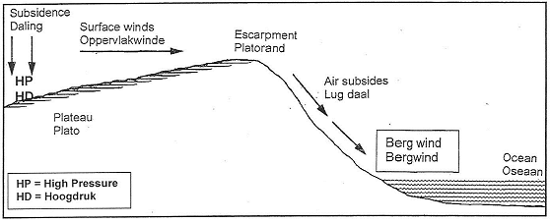
EXAMINATION QUESTION
SUBSIDES - WARMER
DRY – FROM INTERIOR
WARM &
DRY
Name the high pressure cell visible on the diagram. (1x1)
During what season do berg winds affect the weather of South Africa? (1x1)
How does the wind in the diagram affect the weather along the coast of SA? (2x1))
Explain why these weather conditions mentioned in question 3 occur. (1x1)
Name the environmental hazard associated with berg wind conditions. (1x1)
How are berg winds terminated (ended)? (2x2)

Slide 18
VALLEY CLIMATES
Aspect : The direction in which the slope faces.
In Southern H. people chose North facing slope.
Why: They are warmer because the sun is direct.
Middle slopes are preferred
In Katabatic: Bottom of valley has frost/fog

Slide 19
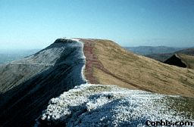
VALLEY CLIMATES ASPECT (SH)
ASPECT: The direction in which the slope faces
PERPENDICULAR
NORTH
SOUTH
WARMER
NO SNOW
SHADOW ZONE
SNOW
COLDER

Slide 20
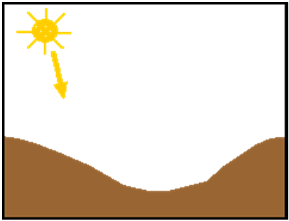
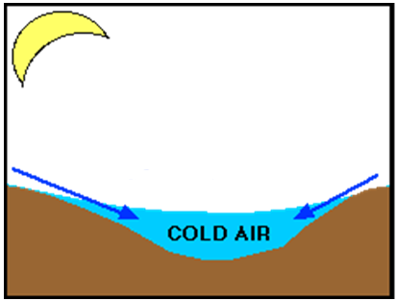
Valley winds: are winds that blow along the length of the valley.
INSOLATION
ANABATIC
KATABATIC
WARM AIR
Cold air decends
During day – land heated
Anabatic winds occurs during the DAY
In the morning the sun heats earth surface
The surrounding air is warmed up and forced to rise
The wind blows UPSLOPE and is known as Anabatic wind
At night the air lose energy through terrestrial radiation and become cold and dense hence SINKS.
Slopes are cooled down and air in contact also cools and SINKS.
Katabatic winds occurs at NIGHT.
4. The wind blows DOWNSLOPE and are known as Katabatic winds.

Slide 21
Urban Climates
Difference between Rural and Urban climates
URBAN CLIMATES
: High temperature in CBD than the surrounding rural areas
Element | Urban versus Rural | Reason
Temperature | Cities are warmer | More artificial, concrete, tarred roads less water bodies, pollution and less vegetation
Wind speed | Less speed in cities | Building act as windbreakers
Humidity | Less in cities | Less plants thus less evapotranspiration Less water bodies due to drains More evaporation due to artificials
Clouds, fog and precipitation | More clouds , fog, smog in urban areas | More dust in cities act as hygroscopic nuclei and promotes condenstaion
Sunshine | Less in cities | High buildings block incoming sun rays and more shadow zone

Slide 22
Urban heat Island: High temperature in cities than the surrounding rural areas
Causes of Urban Heat Island
Solutions/strategies to reduce Urban Heat Island
Tall building which traps heat
Less vegetation that releases oxygen that cools city.
Air pollution that traps heat, as carbon dioxide traps long wave radiation
Artificials like concrete, tarred roads, pavements
Traffic congestion
Plant on roof tops
Plant more vegetation
Use synchronised robots
Flexi business times
Use public transport
Effects of urban heat Island:
Positive effects:
Less heating is required in cold places
Snowfall is reduced and roads are safer
More rainfall and condensation
Negative effects:
More air conditioners which uses more energy
High temperature can lead to stroke, discomfort to people

