Slide 1
Economics
Charmaine Smith

Slide 2
Economics
Term 1: Chapter 4
The Foreign Exchange Market and the Balance of Payments Accounts

Slide 3
Economics
TOPICS
UNIT 1: MAIN REASONS FOR INTERNATIONAL TRADE
UNIT 2: THE BALANCE OF PAYMENTS ACCOUNT
UNIT 3: FOREIGN EXCHANGE MARKETS
UNIT 4: ESTABLISHMENT OF FOREIGN EXCHANGE RATES
UNIT 5: CORRECTIONS OF BOP SURPLUS AND DEFICIT (DISEQUILIBRIA)

Slide 4
Economics
Lesson 3:
Balance of Payments Account
Correction of the Balance of Payment

Slide 5
Economics
Lesson 3:
Unit 2:
The Balance of Payments Account

Slide 6
Economics
Balance of Payment Account
Definition
  Concepts
Composition of the BoP

Slide 7
Economics
Balance of Payment Account
Definition:
Refers to a set of accounts that give a systematic record of outflow of money (import) and inflow of money (export) between a country and the rest of the world during a particular period (quarter or year).

Slide 8
Economics
Balance of Payment Account
Concepts:
It includes transactions of individuals, firms and government and covers exchange of goods, services, assets, gifts and all financial claims.
The transactions are recorded in terms of the national currency – the South African rand (ZAR).

Slide 9
Economics
Balance of Payment Account
Concepts:
The International Monetary Fund (IMF) publishes a Balance of Payment Manual on the rules of recording transactions on the BOP account in order to standardise the accounting process.

Slide 10
Economics
Balance of Payment Account
Concepts:
Receipts of money from abroad are entered as credits and recorded in the account with a positive sign (+). Payments (or outflows of money) are entered as debits and recorded with a negative sign (–).

Slide 11
Economics
Balance of Payment Account
Concepts:
It works in the same way as the accounting records of a business – every transaction is recorded twice; once as a credit and once as a debit. The value of all the transactions must sum to zero.

Slide 12
Economics
Balance of Payment Account
Definition:
A favourable balance of payments usually implies a surplus, which means that more funds are flowing in than leaving.
The South African balance of payments is published quarterly in the SARB Quarterly Bulletin.

Slide 13
Economics
Balance of payment Account
The BoP consist of FOUR sub-accounts:
Components:
Current account
Capital Transfer account
Financial account
Reserve account

Slide 14
Economics
Current Account (difference between inflow out flow of money)
Trade Balance (export less imports)
  Merchandise Exports
  Net gold Exports
  Less Merchandise Imports
Services Receipts/Payment (import and export services)
  Tourism, Consultancy and Transport

Slide 15
Economics
Current Account (difference between inflow out flow of money)
Income Receipts/Payment
  Salaries, interest from investments and profits
Current transfers
  Transfer of money by private individuals and firms

Slide 16
Economics
Capital Transfer Account
Records the transfer of fixed and other assets, such as funds by migrants as well as foreign grants to a country e.g. South Africa receiving a grant from a foreign country to combat HIV/Aids or manage Corona.
Net Lending to (+) or Borrowing from (-) Rest of The World

Slide 17
Economics
Financial Account
Direct investment
  Acquisitions by foreign investors e.g.
(property, share capital in firms, taking over of existing firms or starting new firms in South Africa know as Foreign Direct Investments FDI)
Portfolio investment
  Buying paper assets e.g. shares over stock exchange, government bonds

Slide 18
Economics
Financial Account
Net other investments
  Other financial transactions not covered by FDI e.g. short term investments that flows in and out of a country, trade credits and short term loans
Reserve assets
  Records the country’s holding of gold and foreign reserves, and is meant to correct imbalances.

Slide 19
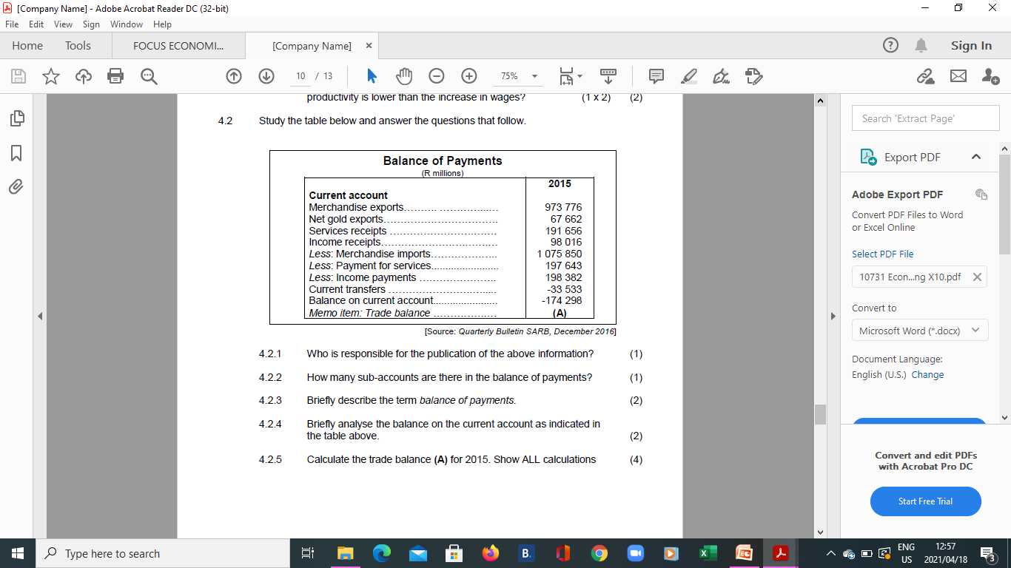
Economics
Activity

Slide 20
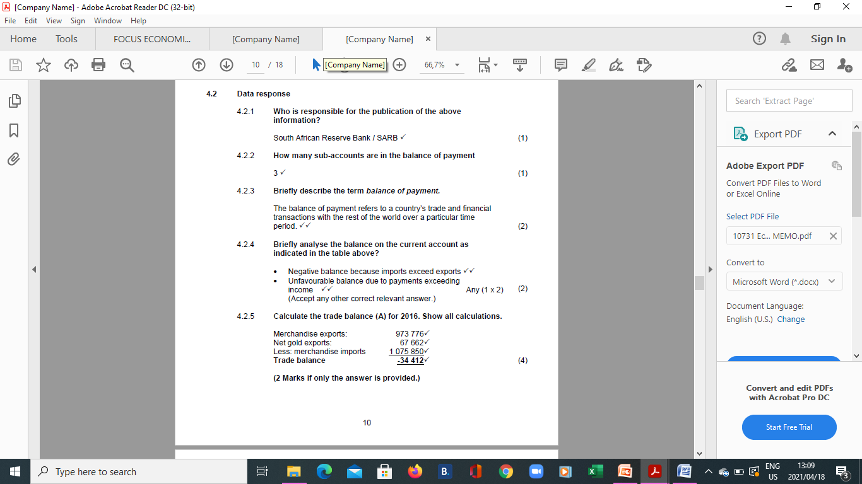
Economics
Solution

Slide 21
Economics
Lesson 3:
Unit 5:
Correction of Balance of Payments Account

Slide 22
Economics
Correction of Balance of Payments Account
  What is BOP Disequilibrium
  How to correct it.
    Lending and Borrowing
    Change in Exchange Rate
    Change in Demand

Slide 23
Economics
Balance of Payment Account
What is BOP Disequilibrium
How to correct it.
    Lending and Borrowing
    Change in Exchange Rate
    Change in Demand

Slide 24
Economics
Correction of Balance of Payments Account
Briefly describe/explain the concepts: corrections and deficit/disequilibria
Briefly discuss the different measures to correct the BoP:

Slide 25
Economics
Correction of Balance of Payments Account:
Explanation
  Balance of payments disequilibria exist when the outflow of foreign currency continuously exceeds or is less than the inflow of foreign currency.

Slide 26
Economics
Correction of Balance of Payments Account:
Explanation
  You will remember that a deficit on the balance of payments implies that the outflow of foreign currency exceeds the inflow of foreign currency while a surplus exists when the outflow is less than the inflow.

Slide 27
Economics
Correction of Balance of Payments Account
  A way to correct balance of payments disequilibrium lies in earning more foreign exchange through more exports and reducing imports.
  The following are methods that can be used to correct the deficit or surpluses on the balance of payments.

Slide 28
Economics
Correction of Balance of Payments Account:
Methods
  Lending and Borrowing
  Change in exchange rates
  Change in demand
    Long term Policies
      Export promotion
      Import substitution
    Interest rates
    Import controls

Slide 29
Economics
Lending and Borrowing
Countries with surpluses often lend money to countries with deficits.
Countries with deficits often borrow. This is why some developing countries have so much foreign debt.

Slide 30
Economics
Lending and Borrowing
In the event of a fundamental disequilibrium, member countries may borrow from the International Monetary Fund (IMF).
Borrowing is nevertheless not a long-term solution for fundamental balance of payments disequilibrium.

Slide 31
Economics
2. Change in exchange rate
Currency depreciation or devaluation makes imports more expensive for domestic consumers and exports cheaper for foreign buyers.

Slide 32
Economics
2. Change in exchange rate
For example, when the rand depreciates, South African goods (exports) become cheaper for foreign buyers. Imports become more expensive for South Africans.

Slide 33
Economics
3. Change in Demand
The following four instruments are used in various countries to restore the equilibrium:

Slide 34
Economics
3. Change in Demand
Long-term policies –
Export promotion, such as government incentives, is applied to encourage the production of goods that can be exported. For example, European countries pay subsidies to farmers.

Slide 35
Economics
3. Change in Demand
Import substitution, for example, government give incentives to produce goods domestically rather than to import them. The South African government favours export promotion.

Slide 36
Economics
3. Change in Demand
Interest rates – Domestic demand can be changed by changing interest rates. If interest rates are increased spending, including on imports, decreases.

Slide 37
Economics
3. Change in Demand
Foreign traders will try to take advantage by increasing their investment in the country with the higher interest rate. The opposite happens when interest rates are decreased.

Slide 38
Economics
3. Change in Demand
Import control – They include import tariffs, other duties and quotas. The WTO is trying to phase them out for the sake of trade liberalisation.

Slide 39
Economics
3. Change in Demand
Exchange control – There are domestic regulations that allow central banks to ration foreign exchange. Earners of foreign exchange are compelled by law to hand it over to the central bank.
Those who require foreign exchange have to apply to the central bank.

Slide 40
Economics
Activity
Discuss the methods government can implement to correct the BoP deficit.

Slide 41

The End

