Slide 1

TECH MATHS
ALGEBRAIC EXPRESSIONS
Gr 11

Slide 2
REVISION OF BASIC CONCEPTS
Writing expressions in exponential form and expanding expressions
EXAMPLE 1
Express the following in exponential form:
(a)
(b)
Notes:
"Textbook, Chapter, Page"

Slide 3
(c)
(d)
EXAMPLE 2
Expand the following:
(a)
(b)
Notes:
"Textbook, Chapter, Page"

Slide 4
EXAMPLE 3
Expand and simplify the following:
(a)
(b)
Notes:
"Textbook, Chapter, Page"

Slide 5
(c)
(d)
Notes:
"Textbook, Chapter, Page"

Slide 6
(e)
Notes:
"Textbook, Chapter, Page"

Slide 7
(f)
Notes:
"Textbook, Chapter, Page"

Slide 8
EXPONENTIAL DEFINITIONS
Definition | Example
1.
2. 1 = 1
a
Notes:
"Textbook, Chapter, Page"

Slide 9
Definition | Example
3.
4.
5.
Notes:
"Textbook, Chapter, Page"

Slide 10
Definition | Example
6.
7.
8.
Notes:
"Textbook, Chapter, Page"

Slide 11
Definition | Example
9.
10.
11.
Notes:
"Textbook, Chapter, Page"

Slide 12
EXAMPLE 5
Simplify the following:
(a)
Definition 1
(b)
Definition 1
(c)
Definition 1
(d)
Definition 1
Notes:
"Textbook, Chapter, Page"

Slide 13
(e)
Definition 2
(f)
Definition 3
(g)
Definition 4
(h)
Definition 5
Notes:
"Textbook, Chapter, Page"

Slide 14
(i)
Definition 6
(j)
Definition 7
(k)
Definition 8
(l)
Definition 9
Notes:
"Textbook, Chapter, Page"

Slide 15
(m)
Definition 10
(n)
Definition 11
Notes:
"Textbook, Chapter, Page"

Slide 16
EXPONENTIAL LAWS
Law | Example
1.
2.
Notes:
"Textbook, Chapter, Page"

Slide 17
Law | Example
3.
Notes:
"Textbook, Chapter, Page"

Slide 18
Law | Example
4.
Notes:
"Textbook, Chapter, Page"

Slide 19
Law | Example
5.
Notes:
"Textbook, Chapter, Page"

Slide 20
EXAMPLE 6
Simplify the following:
(a)
(b)
Law 1
Law 1
Notes:
"Textbook, Chapter, Page"

Slide 21
(c)
Law 1
Add like terms
Notes:
"Textbook, Chapter, Page"

Slide 22
(d)
Law 2
(e)
Law 2
Definition 3
Notes:
"Textbook, Chapter, Page"

Slide 23
(f)
Law 2
Definition 3
Notes:
"Textbook, Chapter, Page"

Slide 24
(g)
Law 3
(h)
Law 4
(i)
Law 4
(j)
Law 4
Notes:
"Textbook, Chapter, Page"

Slide 25
(k)
Law 5
Law 4
Notes:
"Textbook, Chapter, Page"

Slide 26
Multiplication between terms break down the base to its prime factors
EXAMPLE 7
Simplify the following:
Notes:
"Textbook, Chapter, Page"

Slide 27
Notes:
"Textbook, Chapter, Page"

Slide 28
Plus or minus between the terms factorise before you simplify
EXAMPLE 8
Simplify the following:
Notes:
"Textbook, Chapter, Page"

Slide 29
EXAMPLE
Simplify the following:
Notes:
"Textbook, Chapter, Page"

Slide 30
Notes:
"Textbook, Chapter, Page"

Slide 31
LINEAR EQUATIONS
In a LINEAR equation, the highest exponent of the variable is ONE
(To solve- bring the variables to the LHS and numbers to the RHS)
Example :
Solve for x
Notes:
"Textbook, Chapter, Page"

Slide 32


If there is a fraction in an equation, get rid of the fraction by multiplying each term with the LCD
Example :
Solve for x
Notes:
"Textbook, Chapter, Page"

Slide 33
QUADRATIC EQUATIONS
In a QUADRATIC equation, the highest exponent of the variable is TWO
(To solve- bring everything to the LHS and make RHS equal to zero then Factorise)
Example :
Solve for x
Notes:
"Textbook, Chapter, Page"

Slide 34

QUADRATIC EQUATIONS
Example :
Solve for x
Notes:
"Textbook, Chapter, Page"

Slide 35
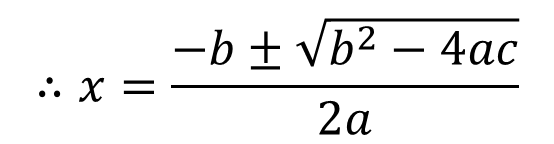



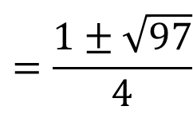
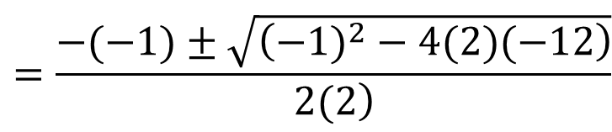
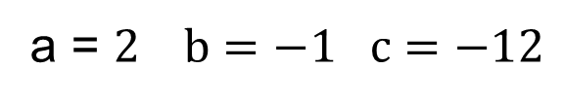
If you cannot factorise use the quadratic formula
Example :
Solve for x
$$2x^{2}+2x−3x−3−9=0$$
$$2x^{2}−x−12=0$$
a = $2 b=−1 c=−12$
$$∴x=\frac{−b±\sqrt{b^{2}−4ac}}{2a}$$
$$=\frac{−(−1)±\sqrt{\left(−1)^{2}−4(2)(−12\right)}}{\left.2(2\right)}$$
$$=\frac{1±\sqrt{97}}{4}$$
$$=2,71 or−2,21$$
Notes:
"Textbook, Chapter, Page"

Slide 36
EXPONENTIAL EQUATIONS
In an exponential equation, the exponent is the unknown.
For example, the equation is called an exponential equation because the unknown variable is the exponent. Clearly, the solution to this equation is
because .
Notes:
"Textbook, Chapter, Page"

Slide 37
Getting the bases on both sides of the equation to be the same and then equating the exponents will solve the equation as follows:
(Write 9 to base 3)
(Equate exponents)
Notes:
"Textbook, Chapter, Page"

Slide 38
EXAMPLE 10
Solve for x:
(a)
(b)
Notes:
"Textbook, Chapter, Page"

Slide 39
(c)
(d)
Notes:
"Textbook, Chapter, Page"

Slide 40
(e)
(f)
Notes:
"Textbook, Chapter, Page"

Slide 41



LOGS
LOG LAWS
eg. log 6 = log 3.2 = log 3+ log 2

Slide 42
IF THERE IS NO BASE THEN THE BASE IS 10

Slide 43
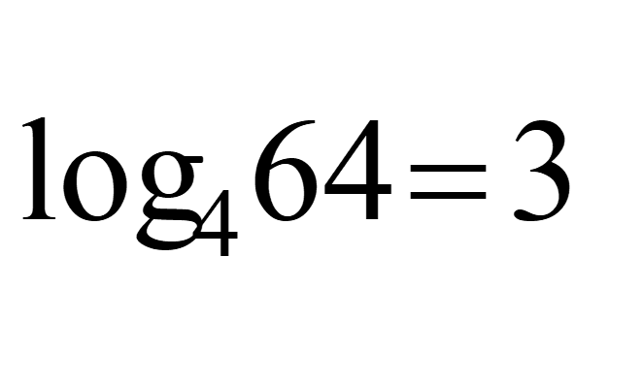


Converting exponential form to log form
Notes:
"Textbook, Chapter, Page"

Slide 44





Application of LOG LAWS
Simplify
APPLY LOG LAW 3
BEFORE YOU SIMPLIFY

Slide 45





APPLY LOG LAW 1
BEFORE YOU SIMPLIFY
APPLY LOG LAW 3
BEFORE YOU SIMPLIFY
Notes:
"Textbook, Chapter, Page"

Slide 46
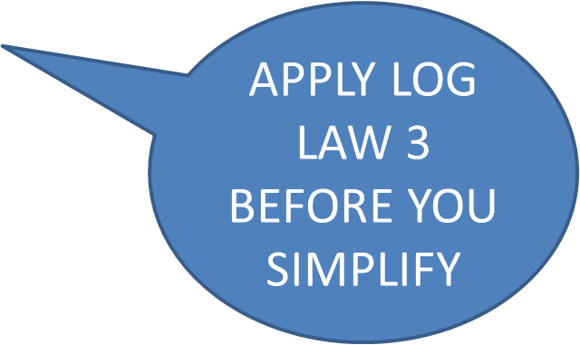



APPLY LOG LAW 1&2
BEFORE YOU SIMPLIFY

Slide 47

LOG EQUATIONS

Slide 48

Notes:
"Textbook, Chapter, Page"

Slide 49
Notes:
"Textbook, Chapter, Page"

Slide 50
Notes:
"Textbook, Chapter, Page"

Slide 51
INEQUALITIES
To solve an INEQUALITY ,solve it in the same way as an EQUATION
Except if you multiply or divide by a negative sign in an equality you must change the sign of the INEQUALITY
eg. Solve for x:
a) -2x +1< 5
-2x > 4
x < -2

Slide 52
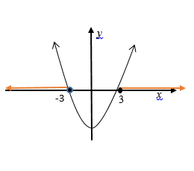
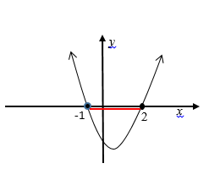
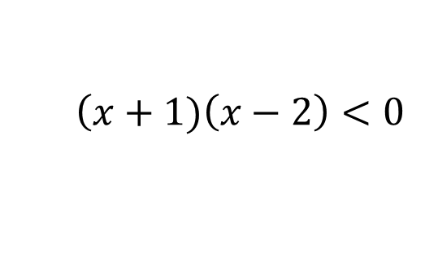
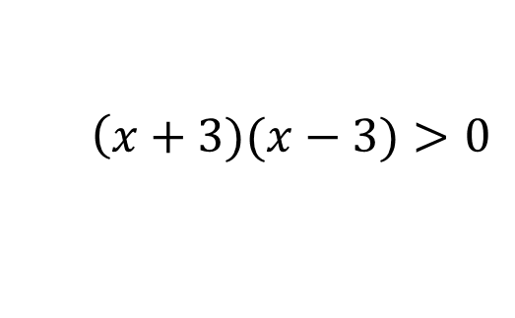


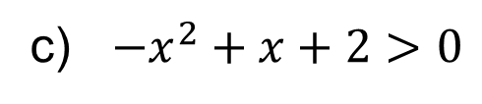


Solve for x:
b) $x^{2}−9>0$
$$\left(x+3)(x−3)>0\right.$$
$∴x<−3 or x>3$
c) ${−x}^{2}+x+2>0$
$$x^{2}−x−2<0$$
$$\left(x+1)\left(x−2\right)<0\right.$$
$$∴−1<x<2$$

Slide 53

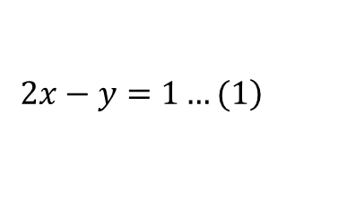




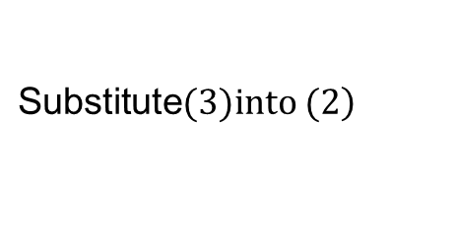

SIMULTANEOUS EQUATIONS
$$\left.2x−y=1…(1\right)$$
$$\left.\text{Substitute}(3)\text{into} (2\right)$$
$$3x^{2}−4x(2x−1)²+y²=0$$
$$3x^{2}−8x^{2}+4x+4x^{2}−4x+1=0$$
$$−x^{2}+1=0$$
$$1=x^{2}$$
$$∴x=1 or x=−1$$
$$y=2\left(1\right)−1 \text{or} y=2(−1)−1$$
$$y=1 \text{or} y=−3$$

Slide 54




SURDS

Slide 56




RATIONALISE THE DENOMINATOR

Slide 57





Slide 58
NATURE OF THE ROOTS

Slide 59
EXAMPLE

Slide 60
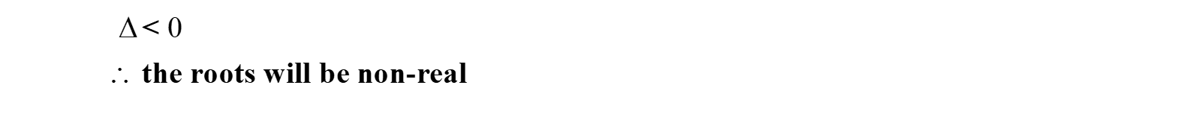
EXAMPLE

Slide 61
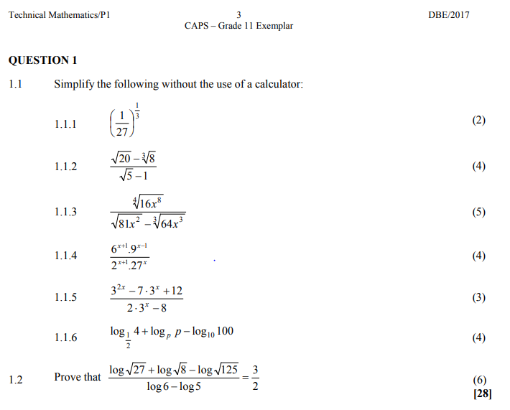

Slide 62


Slide 63


Slide 64


Slide 65


Slide 66


Slide 67


Slide 68


Slide 69
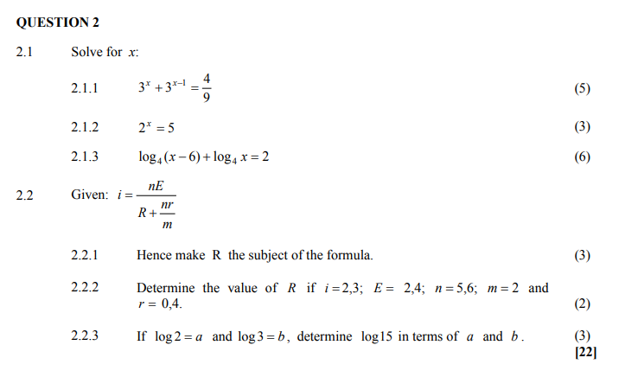

Slide 70


Slide 71


Slide 72


Slide 73
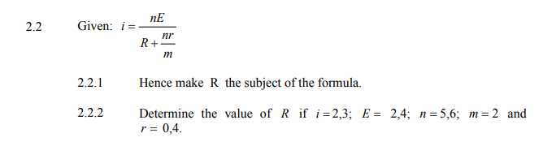

Slide 74


Slide 75
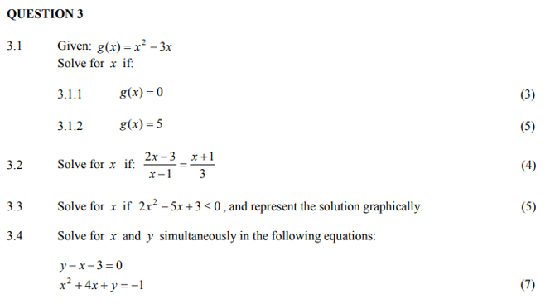

Slide 76
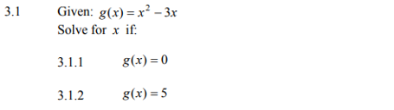

Slide 77


Slide 79
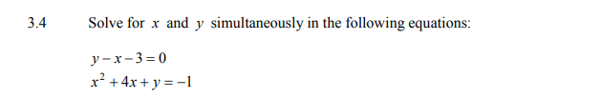

Slide 81
THE END

