Slide 1
HUMAN REPRODUCTION
Life Sciences

Slide 2
Life Sciences
Key Points: Human Reproduction
Role of Meiosis, Fertilisation and Mitosis
The Male System – Structure and Functions
Female System – Structure and Functions
Gametogenesis
Diagrams of a Sperm cell and Ovum
The Menstrual Cycle

Slide 3
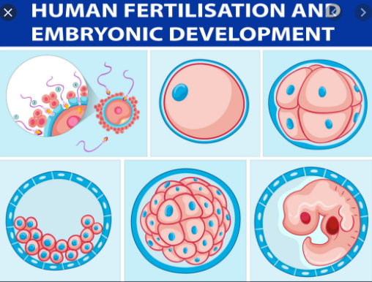
Life Sciences
Meiosis
Mitosis
Fertilisation
Zygote
From Vectorstock.com

Slide 4
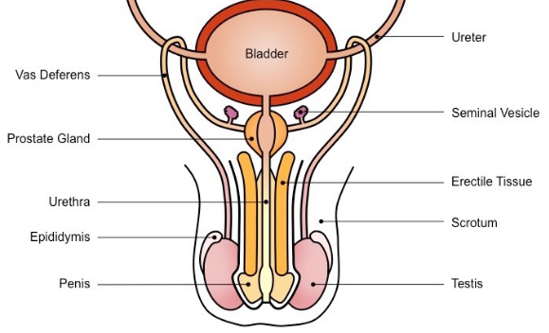
Life Sciences
Male Reproductive System
Transports Sperm
Secrete Fructose
Alkaline Fluid
O
O
Cowper’s Gland
Fluid Medium
Duct for Urine & Semen
Protect & Control Temperature
Sperm Mature
Produce Sperm & Secrete Testosterone
From: BioNinja

Slide 5
Life Sciences
Male System – What are the Functions of …?
Testes
Epididymis
Vas Deferens
Seminal Vesicles
Prostate Gland
Cowper’s Gland
Urethra

Slide 6
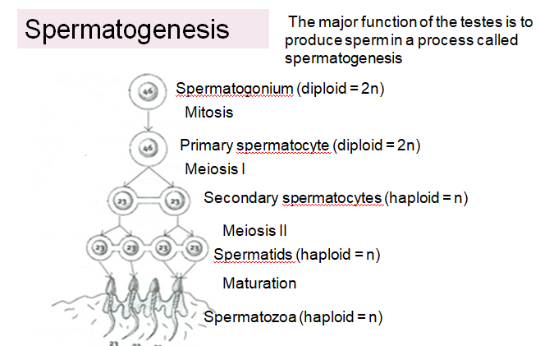
Life Sciences
1. Under Influence of Testosterone
D
2. Diploid Cells in Seminiferous Tubes
3. Undergo Meiosis
4. To Form Haploid Sperm Cells

Slide 7
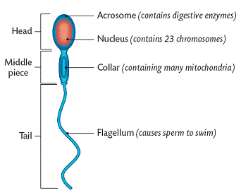
Life Sciences
Human Sperm Cell

Slide 8
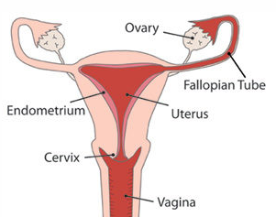
Life Sciences
Female Reproductive System
1. Produce Ova & Female Hormones – Oestrogen & Progesterone
Where Fertilisation Occurs
Implantation of Embryo
Nurtures & Protects the Foetus
Barrier to Germs

Slide 9
Life Sciences
Female System – What are the Functions of …?
Ovaries
Fallopian Tubes
Uterus
Endometrium
Cervix

Slide 10
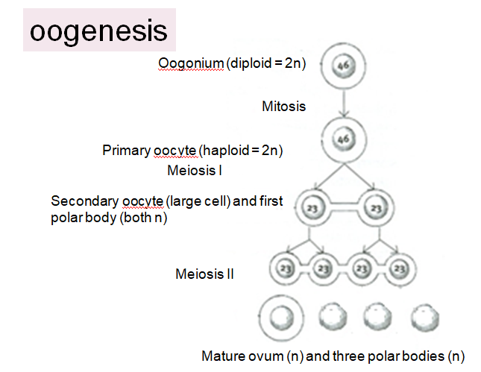
Life Sciences
1. Diploid Cells in Ovary Undergo Mitosis
2. to form many follicles during puberty
3. Under the influence of FSH
4. One cell in a follicle undergoes Meiosis
5. Of 4 cells produced, 1 becomes a mature haploid ovum
6. This occurs in a monthly cycle

Slide 11
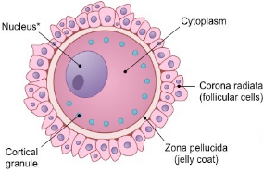
Life Sciences
Human Ovum

Slide 12
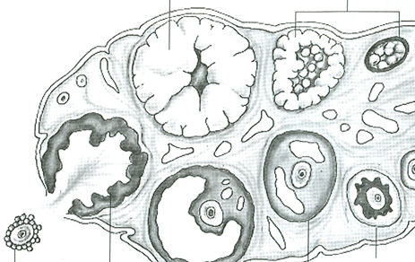


Life Sciences
Internal structure of an Ovary
Day
C
Ovarian Cycle – 28 days
Graafian Follicle
O
Secondary
Follicle
Primary Follicle
Day

Slide 13
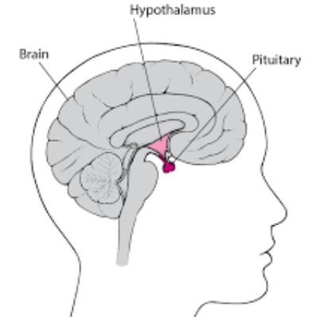


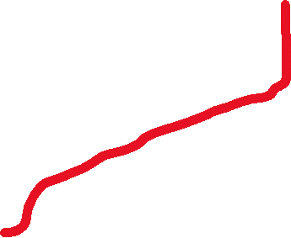

Life Sciences
Female Hormones during the Ovarian Cycle
P
F
L
O

Slide 14
Life Sciences
Menstrual Cycle: The effect of Oestrogen and Progesterone on the Uterus every 28 days

Slide 15
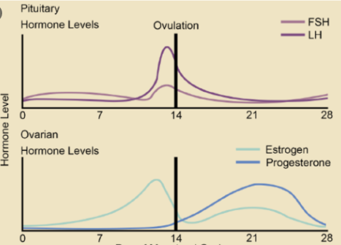
Life Sciences
Hormone Levels of the - 28 day - Menstrual Cycle
Biology LibreTexts

Slide 16
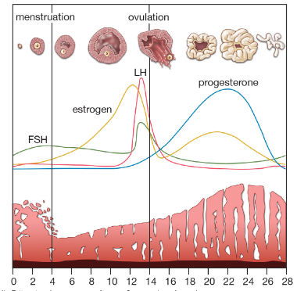
Life Sciences
Hormone Levels of the - 28 day - Menstrual Cycle
2013 Ecyclopaedia Britannica

Slide 17
Life Sciences
Key Points: Human Reproduction
Role of Meiosis, Fertilisation and Mitosis
The Male System – Structure and Functions
Female System – Structure and Functions
Gametogenesis
Diagrams of a Sperm cell and Ovum
The Menstrual Cycle

