Slide 1
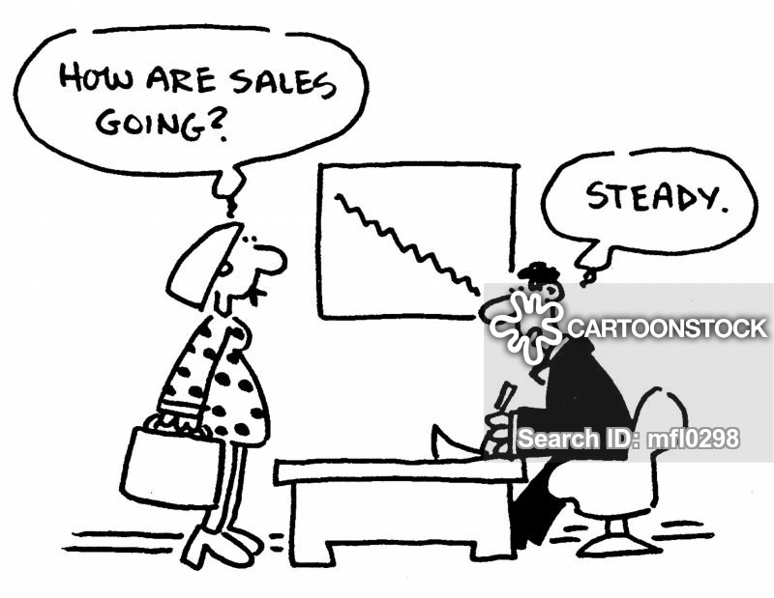
BUSINESS CYCLES

Slide 2
The Composition and features of a business cycle
What is a business cycle?
Business cycles are successive periods of fluctuations in economic activity.
The national output of a country does not grow in a steady fashion from one year to the next.

Slide 3
All countries experience an economic cycle which tracks the fluctuations in the rate of growth of a country’s Gross Domestic Product.
The business cycle can also be defined as the upward and downward movements of levels of gross domestic product (GDP) or refers to the period of expansions and contractions in the level of economic activities (business fluctuations) around its long-term growth trend.
These fluctuations occur around a long-term growth trend, and typically involve shifts over time between periods of relatively rapid economic growth (an expansion or boom), and periods of relative stagnation or decline (contraction of recession).

Slide 4
BUSINESS CYCLES ARE RECOGNISED BY THE FOLLOWING
Two periods, i.e. contraction and expansion
Two turning points, i.e. trough and peak
Four phases, namely recovery, prosperity, recession and depression.

Slide 5
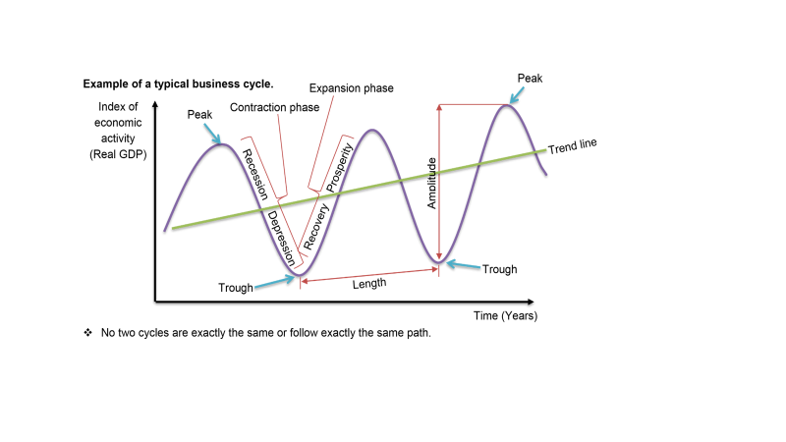

Slide 6
Expansion (recovery & prosperity)
Contraction (recession & depression)

Slide 7

Recovery phase
Production increases and more jobs are created
Business sentiment rises and there is increased spending by firms (I)
There is increased economic activity and the country enters into a period of prosperity.
Exports increase, the value of the rand appreciates, inflation falls/decreases

Slide 8
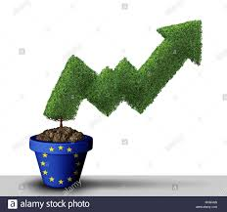
Prosperity phase (boom)
There is a great degree of optimism.
Employment levels rise, salaries and wages rise and spending increases
A larger amount of money is in circulation and this leads to an inflationary situation
Deficit on current account of B.O.P, high demand for credit, interest rates increase

Slide 9
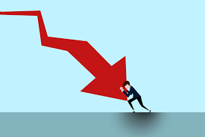
Recession
Jobs are lost and there is a feeling of pessimism
Employment levels drop, and there is a decrease in economic activity, and the economy slows down.
The value of the rand depreciates, inflation increases, interest rates will increase, demand for credit as a result of the increased interest rates will fall, surplus on current account of B.O.P.

Slide 10

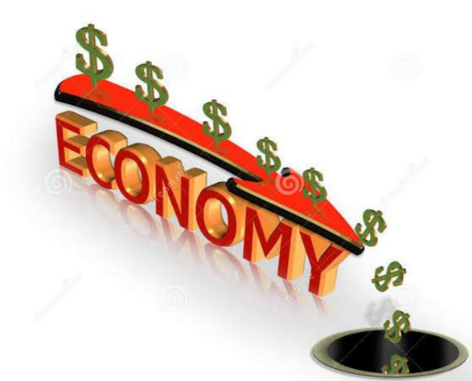
Depression
Money is in short supply leading to a further decline in spending
There is a negative impact on investment spending
When economic activity is at its lowest, a trough is reached
There is competition for jobs and the cost of production decreases
This encourages foreign trade and leads to recovery.

Slide 11
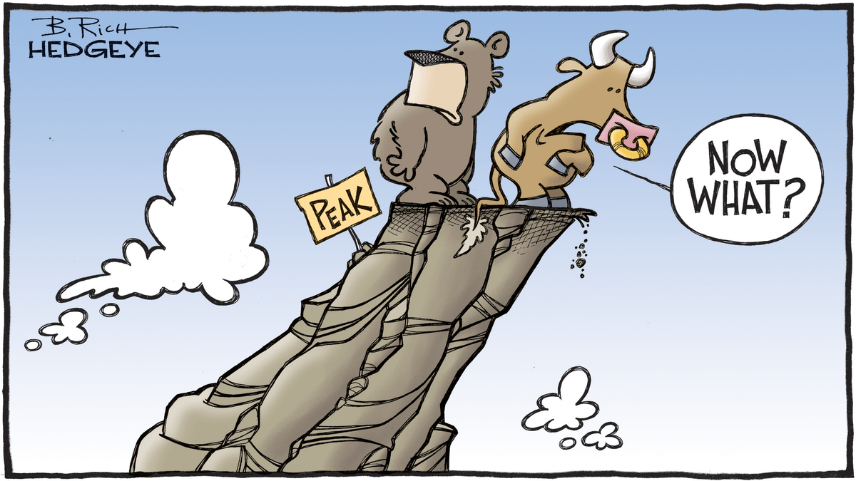
The two turning points
Peak
Turning point at the end of the prosperity phase
The economy is using most of its resources, such as skilled labour and capital
There is an upward pressure on prices
Balance on the current account worsens as a result of higher imports

Slide 12
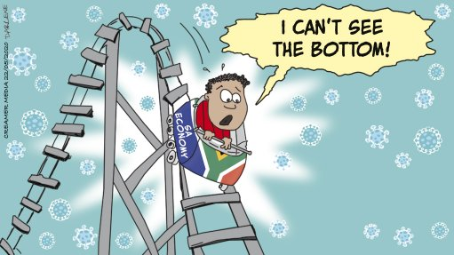
Trough
Turning point at the end of the contraction period
Unemployment is high
Income levels are low
Low levels of investments by firms and low savings by households

Slide 13
EXPLANATION FOR BUSINESS CYCLES
Exogenous causes are factors that influence the business cycle from outside of the system, e.g. climate (drought and other natural disasters) and the political situation of a country.
Endogenous causes are factors that influence the business cycle from inside the system, e.g. total expenditure.

Slide 14
 | Exogenous causes of the business cycle | Endogenous causes of the business cycle
Basic assumption | The market economy is inherently stable | The market economy is inherently unstable
Causes of economic fluctuations | Factors which originate outside the market system, such as weather conditions and the outbreak of a war. | Factors which originate within the market system, such as changes in patterns of consumer spending.
Government’s responsibility | Economic fluctuations are exacerbated by the government intervention in the market and thus government should refrain from intervention in the market | Government have a duty to use monetary and fiscal policy to intervene in the market in order to stabilise the economy
Supporters of this view | Monetarist approach | Keynesian approach

Slide 15
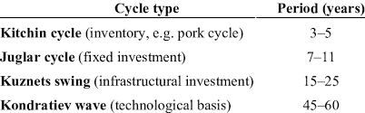
KINDS OF BUSINESS CYCLES

Slide 16
GOVERNMENT POLICY
Monetary policy | Fiscal policy
This policy is the approach taken by a country’s central bank to influence spending in an economy by influencing the interest rate (Repo rate) and the money supply | This policy is the approach the government takes to taxation and government spending in order to regulate the economy
In SA monetary policy is determined by the Monetary Policy Committee (MPC) of the SARB, which is led by the, Governor Mr Lesetja Kganyago | When the government uses the national budget to influence economic activity, then this referred to as fiscal policy.
 | In SA the National Treasury is in charge of fiscal policy, led by the Minister of Finance. Currently Mr Tito Mboweni

Slide 17
MONETARY FISCAL
While the aim of the MPC is to control inflation, monetary policy has the additional aim of Increasing economic growth Decreasing unemployment | Fiscal policy has three main aims: Increasing economics growth Decreasing unemployment Protecting against an increase in inflation

Slide 18
THE NEW PARADIGM
This discourages policy makers from using the monetary and
fiscal policy to fine-tune the economy, but rather encourages
achieving stability through sound long-term policy decisions
relating to demand (consumers) and supply (producers)

Slide 19
DEMAND SIDE
Demand side aim is to :
increase or decrease aggregate demand depending on the stage of the business cycle.
The key to understanding demand-side policies is consumption.
When the C, G and I spend more, demand increases
This result in an increase in the total level of output (real GDP)

Slide 20
SUPPLY-SIDE
Supply-side aim is to:
Improve an economy’s ability to produce more products to meet the demand of the consumers.
This can be done - stimulating the economy by:
Reduction of costs of production
Improving the efficiency of input
Improving the efficiency of the market

Slide 21
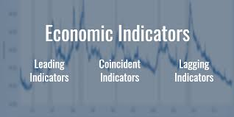
FEATURESUNDERPINNING, FORECASTING BUSINESS CYCLES

Slide 22
Length/duration of a cycle
The length of the businesses cycle is measured from peak to peak or from trough to trough.
Longer cycles show strength and shorter cycles show weakness with regard to economic activities.

Slide 23
Amplitude
Amplitude refers to the vertical difference between a trough and a trendline or the vertical difference between the peak and the trendline.
It shows the intensity of the underlying forces and the size of change.
The larger the amplitude, the stronger the forces in the economy and shows extreme expansion and contraction of economic activity
Low or small amplitude indicates weak forces in the economy. The expansion and contraction of economic activity is moderate.

Slide 24
Trend line
It indicates the general direction in which the economy is moving.
It represents the average position of a business cycle.
An upward trendline or the one with a positive slope indicates economic growth.

Slide 25
Extrapolation
This means using historical data to predict the future.

Slide 26
Moving averages
This refers to the average price of an indicator over a specified time period.
Moving averages are used to look at price trends.

